Slide 1

KONGUNADU COLLEGE OF ENGINEERING & TECHNOLOGY
(AUTONOMOUS)
NAMAKKAL- TRICHY MAIN ROAD, THOTTIAM DEPARTMENT OF COMPUTER SCIENCE AND ENGINEERING
MINI PROJECT I
PROJECT GUIDE:
Mr.M.Thangadurai (ASP/CSE)
PROJECT TEAM:
Abdul rahuman S (621323104001)
Jeyanth priyan B (621323104053)
Mukesh B (621323104302)
BATCH NO:21

Slide 2
Smart Bed Using Health Care Monitoring System

Slide 3
ABSTRACT
The integration of Internet of Things (IoT) technology in healthcare has enabled the development of intelligent systems that provide continuous patient monitoring and timely medical assistance. This project, medical health care monitoring System using IoT, aims to monitor the vital health parameters of patients such as body temperature, heart rate, oxygen saturation, and blood pressure using a network of sensors. The system detects whether the patient is lying in bed and collects health data in real time. The sensed data is transmitted to an IoT-enabled microcontroller, for remote access by doctors and nurses through a web or mobile application. If any abnormal condition is detected, such as a sudden drop in oxygen level or irregular heart rate, the system generates an alert notification to healthcare providers, ensuring immediate medical response. This IoT-based monitoring system reduces the dependency on manual supervision, enhances patient safety, and improves the efficiency of healthcare delivery, especially for bedridden and critical patients.

Slide 4
INTRODUCTION
Healthcare technology has advanced significantly, yet continuous and real-time patient monitoring in hospitals and home care settings remains a challenge. Manual monitoring often leads to delays in detecting critical health changes, putting patients at risk.
This project aims to develop a Smart Bed Patient Monitoring System using the Internet of Things (IoT) to provide automated, real-time health tracking. The system uses sensors to monitor:
Patient presence on the bed
Heart rate and blood pressure
IV fluid levels
Whenever abnormal readings are detected, the system sends alerts through notifications, mobile app updates, or SMS to healthcare providers. The data is also uploaded to the cloud via Firebase for real-time access.

Slide 5
LITERATURE SURVEY
S.No | Authors & Year of Publication | Journal | Title of the paper | Advantages & Limitations
1. | R. Kumar, S. Rajendran (2020) | International Journal of IoT Applications | IoT-Based Real-Time Patient Health Monitoring System | Real-time monitoring basic sensors only.
2. | A. Sharma, P. Gupta (2021) | International Journal of Computer Science & Engg | Smart Bed with Heart Rate and SpO2 Monitoring using NodeMCU and Firebase. | Mobile app alerts limited to single patient
3. | D. Patel, S. Mehta (2022) | International Journal of Electronics & Comm. Engg | Patient Health Monitoring with SMS and Voice Alerts | SMS alerts implemented; no cloud data storage

Slide 6
LITERATURE SURVEY
S.No | Authors & Year of Publication | Journal | Title of the paper | Advantages & Limitations
4. | Mujeeb Rahman K K Mohamed Nasor M Rayan Zidan Ibrahim Alsarraj Besher Hasan | International Journal of Engineering Research & Technology | IoT-based wireless patient monitoring system using ESP32 & Firebase | Uses the ESP32 microcontroller and Firebase for remote access via a web/app. Focuses on improving accessibility and monitoring patients remotely, especially in rural areas.
5. | S. K. Swarnkar, Y. K. Rathore (2024) | International Journal of Creative Research Thoughts | IoT Based Vital Track and Fluid Monitoring | Integrates simultaneous monitoring of IV fluid levels (using load cell sensor), SpO_2, heart rate, and temperature. effectiveness in reducing manual workload and minimizing human error in complex monitoring tasks

Slide 7
EXISTING SYSTEM
In the current healthcare setups, patient health monitoring is often done manually by nurses or healthcare staff.
Vital signs such as heart rate, blood pressure, temperature, and IV fluid levels are checked periodically, not continuously.
Alerts for critical conditions rely on human observation instead of automated systems.
Some basic monitoring devices exist but are standalone systems without real-time mobile app notifications or cloud data storage.
Lack of integration with IoT and remote access limits the efficiency of existing solutions.

Slide 8
DISADVANTAGES
Standalone Devices, working individually with no integrated system for multiple health parameters.
Human Error is a risk because manual observation may lead to mistakes, missed alerts, or delayed responses.
Limited Automation, meaning there are no automatic voice or SMS alerts for critical health conditions.
Manual Monitoring, requiring nurses or staff to check vitals periodically instead of continuous real-time tracking.

Slide 9
PROPOSED SYSTEM
Continuous Monitoring: Heart rate, blood pressure, IV fluid level,
and patient presence are monitored using sensors.
IoT Integration: All sensor data is processed by NodeMCU
and uploaded to Firebase Cloud.
Real-Time Alerts: Alerts via voice notifications, mobile app,
or SMS if any parameter crosses the critical threshold.
Low-Cost, Scalable Solution: Uses affordable sensors and microcontrollers
suitable for hospitals and home healthcare.

Slide 10
ADVANTAGES
Real-Time Monitoring – Continuously tracks vital health parameters like heart rate, blood pressure, IV fluid level, and patient presence.
Instant Alerts – Provides automatic voice alerts, SMS notifications, and mobile app updates during emergencies.
Remote Accessibility – Doctors and caregivers can access patient health data anytime, anywhere through a mobile app or cloud.
Reduces Manual Effort – Minimizes the need for frequent manual checks by nurses, improving efficiency and reducing human error

Slide 11
HARDWARE REQUIREMENTS
Microcontroller: NodeMCU (ESP8266) for data collection & WiFi connectivity
Sensors:
MAX30100 / MAX30102 → Heart Rate & SpO2
DHT11 / LM35 → Temperature
IR Sensor / Load Cell → IV Fluid Level Detection
FSR Sensor → Patient Motion Detection
BP Sensor (Optional) → Blood Pressure Monitoring
Alert Modules:
DFPlayer Mini with Speaker → Voice Alerts
GSM SIM800L Module → SMS Alerts (optional)
Display: 16x2 LCD (Optional for local display)
Power Supply: 5V Adapter / Power Bank

Slide 12
SOFTWARE REQUIREMENTS
Programming Language: Arduino C/C++, Embedded C
Development Environment: Arduino IDE
Libraries Used:
Adafruit_MAX30100 (Heart Rate & SpO2 Sensor)
DHT (Temperature Sensor)
HX711 (Load Cell)
Firebase ESP8266 Library

Slide 13
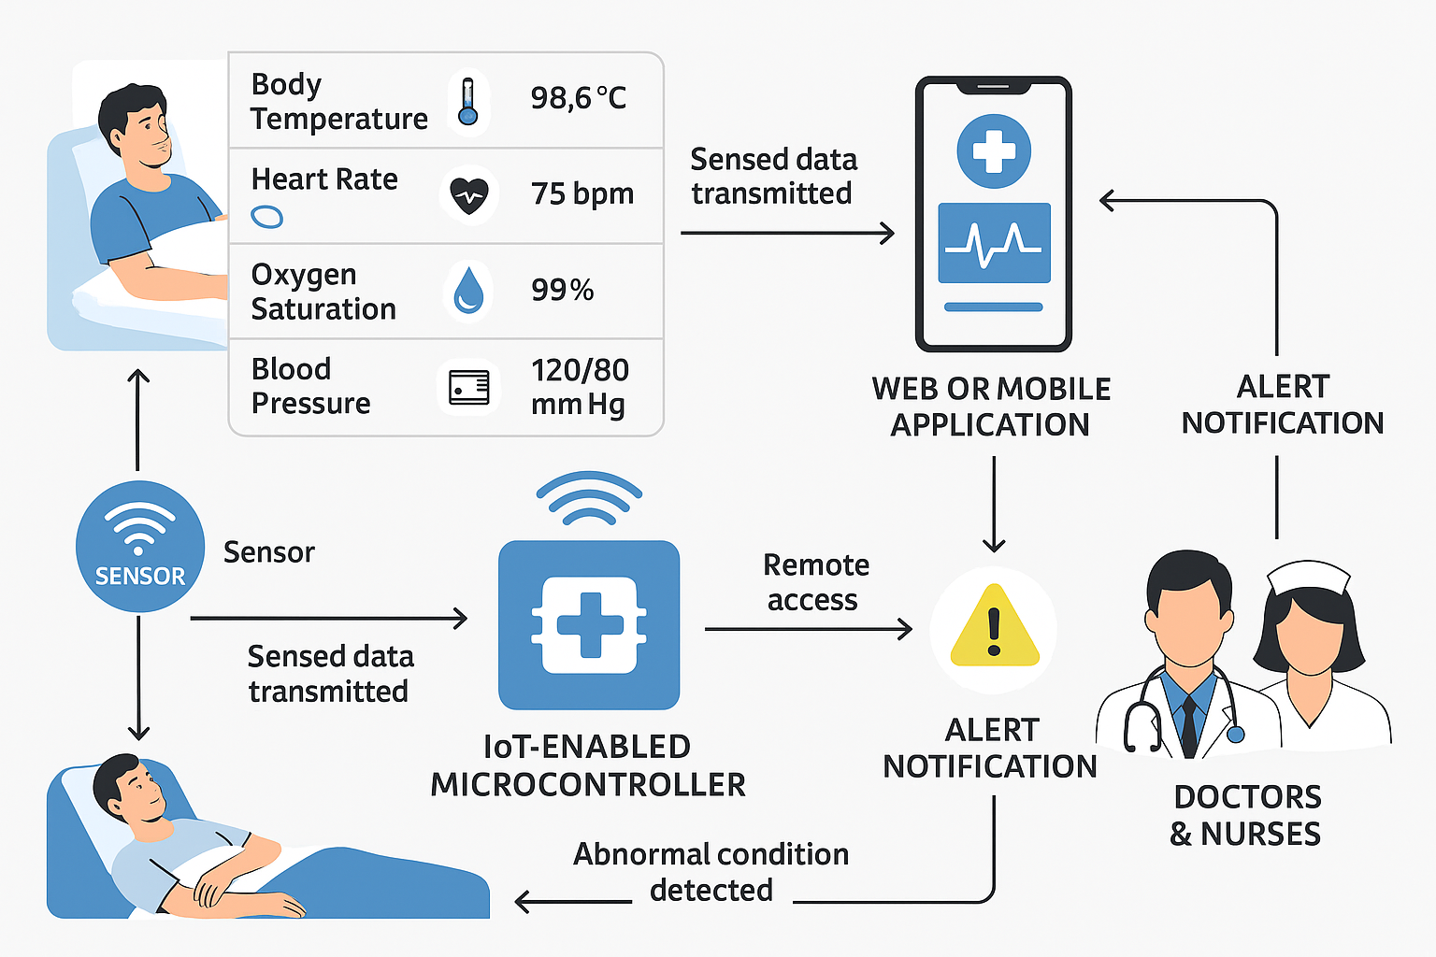
ARCHITECTURE DIAGRAM

Slide 14
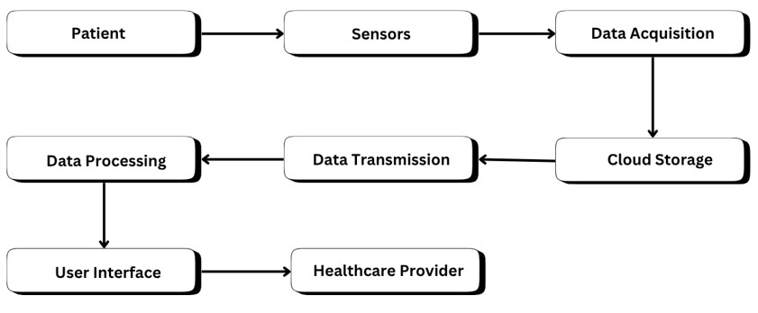
Data flow diagram
Leval 0

Slide 15
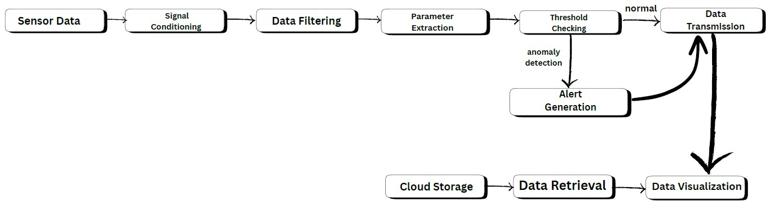
Data flow diagram
Leval 1

Slide 16
MODULES
Module 1: Sensing Module
Module 2 : processing Module
Module 3 : communication Module & alert Module

Slide 17
MODULES
Sensing Module
Primary Function: Collects real-time patient health data and
detects physical patient presence.
Monitored Vital Signs: Monitors heart rate, blood pressure, and IV fluid levels.
Key Sensor Components: Uses MAX30100/MAX30102 for heart rate
and the FSR Sensor for patient presence.
Output: Generates sensed data that reflects the patient's current health status

Slide 18
MODULES processing Module
Core Component: Uses the NodeMCU (ESP8266) microcontroller to
handle the core logic of the system.
Data Handling: Receives and processes the sensed data from all
connected sensors.
Abnormal Detection: Continuously checks if any health parameter or
IV fluid level has crossed a critical threshold.
IoT Integration: Utilizes the NodeMCU's WiFi capability to upload the
processed data to the Firebase Cloud

Slide 19
MODULES communication Module & alert Module
Remote Access: Transmits data to a web or mobile application for access by doctors and nurses anytime, anywhere.
Instant Alerts: Generates a notification if an abnormal condition is detected, ensuring immediate medical response.
Alert Methods: Alerts are sent via multiple channels, including voice notifications, SMS (GSM SIM800L Module), and mobile app updates.
Purpose: Enhances patient safety and reduces dependency on manual supervision through continuous, automated monitoring.

Slide 20
CONCLUSION
It provides continuous, reliable, and real-time monitoring of patients.
It also monitors IV fluid level automatically.
The system gives alerts when patient health or IV level becomes critical.
It Improves patient safety and reduces manual errors.
Useful in hospitals, home healthcare, and elderly care.

Slide 21
FUTURE ENHANCEMENT
AI & Predictive Analytics – Detect health risks early and assist doctors with smart decision-making.
Centralized & Remote Monitoring – Manage multiple patients through a unified dashboard and wearable devices.
EHR/HIS Integration – Automatically update patient records for accurate and efficient data handling.
Voice, Power & Telemedicine Features – Enable hands-free control, energy efficiency, and virtual doctor consultations.
Security & Accessibility – Use blockchain for data protection and support multiple languages for global use.

Slide 22
THANK YOU!

